Slide 1



Unlocking Opportunities:
Navigating Bookable Product in the Travel Industry
Notes:
BC

Slide 2
WIFI LOGIN
NETWORK
RURAL ROUNDUP
PASSWORD
RRU2024

Slide 3
What is
bookable
product?

Slide 4

Bookable Product
Tangible and intangible tourism experiences and services
Travelers can purchase as a single item or in a packaged bundle
Built to be in alignment with destination target markets, travel & tourism trends, and destination strategic plans.
Celebrates the authentic character of your rural destination
Notes:
At its most basic level, a bookable product is quite simply – a product, experience or service that has an attached dollar amount.
Bookable product can be as simple as a hotel room, or tickets to an attraction, or a rental car. Or it can be a series of items that when packaged together creates an overarching experience.
Packaging is a great way to monetize a “free product or experience.”
At it’s core, successful bookable product is created with a target audience in mind, is aligned with destination strategies and branding, and is true to the authentic character of the destination.

Slide 5
WhY is
bookable
Product
Important?
Notes:
Why are having a whole session on bookable product at this year’s Rural Round Up?

Slide 6
Connectivity
Pathway to Purchase
Rural Nevada
Travel & Trade Partners
Domestic & International Travelers
Distribution Platforms
Bookable Products
Notes:
If a product/experience/service doesn’t have price attached, then there isn’t any way for travel and trade partners to sell them.
Today we are going to explore the bookable product from the perspective of a rural partner, a receptive tour operator, and an OTA.

Slide 7

Meet the Panel
Notes:
I am excited for the opportunity to introduce you all to our panel of experts:

Slide 8
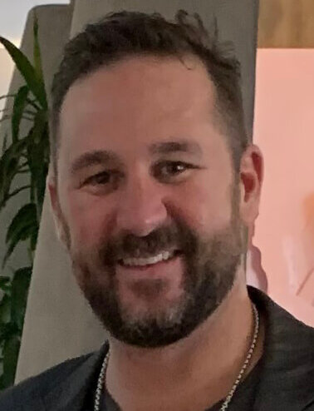
Chad Taylor
Director of Marketing & Guest Experience,
Lake Mead Mohave Adventures (LMMA)
Notes:
is the Director of Marketing and Guest Experience and six-year veteran of Lake Mead Mohave Adventures (LMMA). In his current role Chad oversees and coordinates upwards of 100 marketing channels for data aggregation and decision making. As Director of Marketing, Chad is responsible for overseeing creative, and strategic partnerships to expand or initiate new revenue streams and to grow sales across LMMAs seven resorts and marinas. Chad is a core committee member for Adventures Unbound, a new national hospitality brand for Guest Services, Inc.

Slide 9
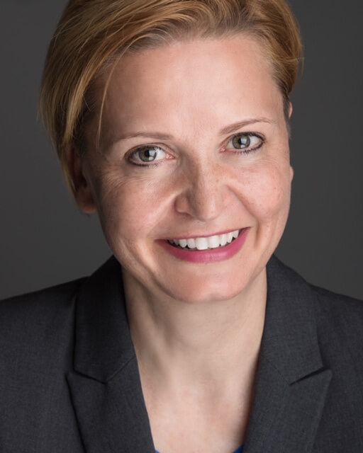
Karin Omojola
Vice President Product,
American Tours International (ATI)
Notes:
Is the VP of Product for American Tours International (ATI), Karin Omojola oversees the contracting and marketing efforts for FIT, Motor Coach Groups, Drive America self-drive programs, Transportation and Attractions.
ATI is North America’s leading travel service provider who’s mission of innovation, not duplication when it comes to connecting over 30,000 accommodations, attractions, and transportation suppliers to customers worldwide.
ATI’s Drive America concept offers travelers the flexibility to explore the USA and Canada through customized bespoke individual road trips.

Slide 10
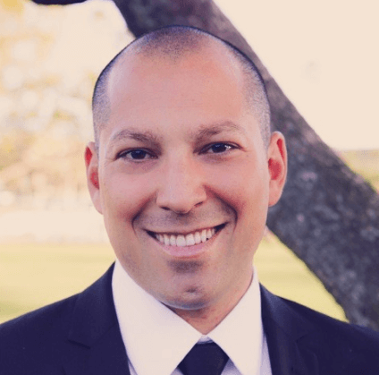
Felipe Tetelboin
Sr. Manager of Business Development,
Expedia Group Media Solutions
Notes:
is Senior Manager of Business Development at Expedia Group Media Solutions, where he works with advertising partners to deliver global marketing programs and is responsible for the creation and implementation of digital media campaigns. Felipe brings a vast knowledge of online travel agencies and airlines to Expedia and has spent over a decade in the travel industry

Slide 11
Booking Software: Digital platform that manages products and bookings.
Distribution Channels: Digital tool that connects products/services to consumers.
Channel Manager: Connects product to consumers, via resellers.
Receptive Tour Operator (RTO): Specialist in their area. Liaison between suppliers/destinations and wholesalers. Develops products and packages through contracts with tourism suppliers (i.e. hotels and attractions).
FIT: Originally Foreign Individual Traveler, now Flexible Independent Traveler/Fully Independent Traveler/Free Independent Traveler”.
B2B / B2C / B2B2C: Business to Business / Business to Consumer / Business to Business to Consumer.
GIT: Group Inclusive Travel (i.e. Motorcoach Tours).
Contracted rate: Negotiated static rate offered to FIT and/or Group Travel between hotel/attraction.
7 P’s of Marketing: Product, Price, Package, Place, Partnership, Promotion, and People.
Pathway to Purchase (Customer Journey): Inspiration, Research, Planning, and Booking.

Slide 12
Notes:
Felipe

Slide 13
Notes:
Felipe

Slide 14
Notes:
Felipe

Slide 15
Notes:
Felipe

Slide 16
Notes:
Felipe

Slide 17

Notes:
Last slide and then Matthew comes on stage

