Slide 1
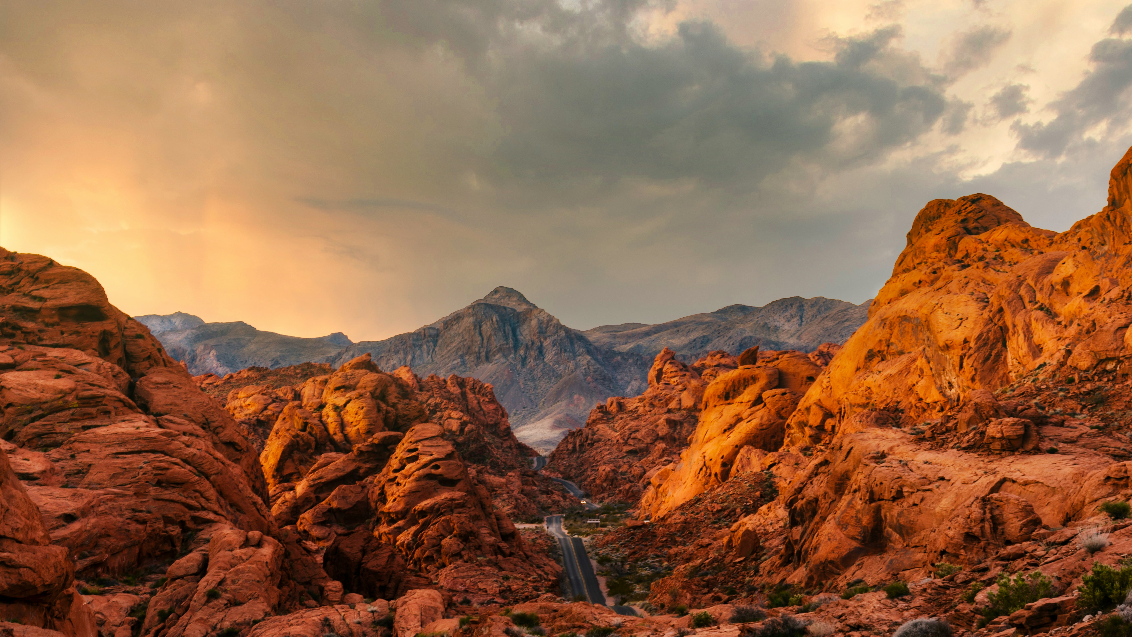

You Take Care Now
Embracing Destination Stewardship in an Age of Change
Travel Nevada Rural Roundup, April 2024
Notes:
You Take Care Now: Embracing Destination Stewardship in an Age of Change
As the world of travel & tourism changes, destination organizations are being called upon to do much more than marketing—often, this means taking on a role of stewardship. Amidst a bewildering sea of certifications and green labels, there’s a core ethos that can guide your destination. Using real-world case studies, this presentation will offer a concise definition of destination stewardship, share a variety of approaches to stewardship, highlight ways to use data to keep your eye on the ball, and share three easy things that every destination can do to become better stewards of their place.
joel protasio on Unsplash

Slide 2
An Age of Change

Slide 3
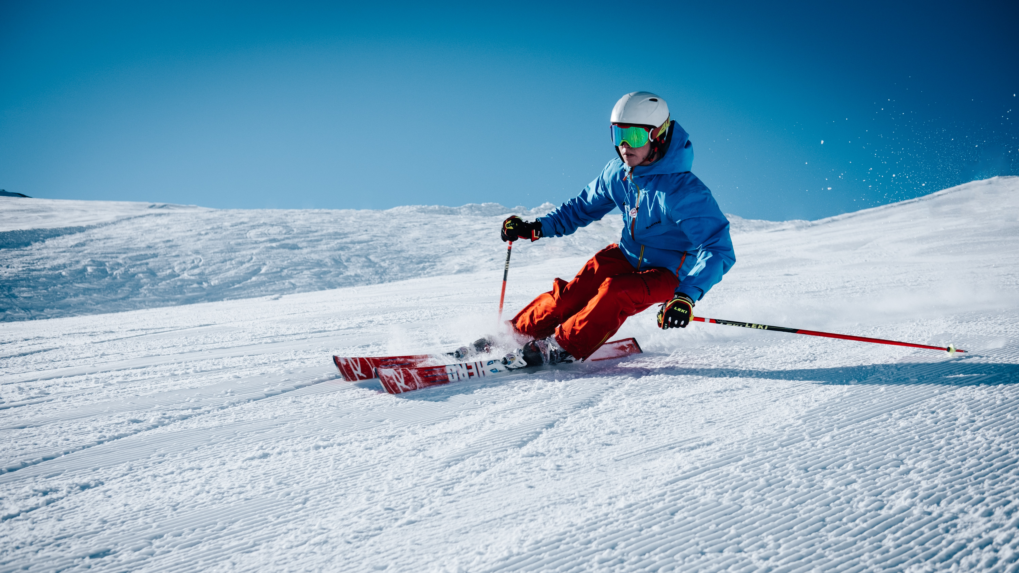


Slide 5
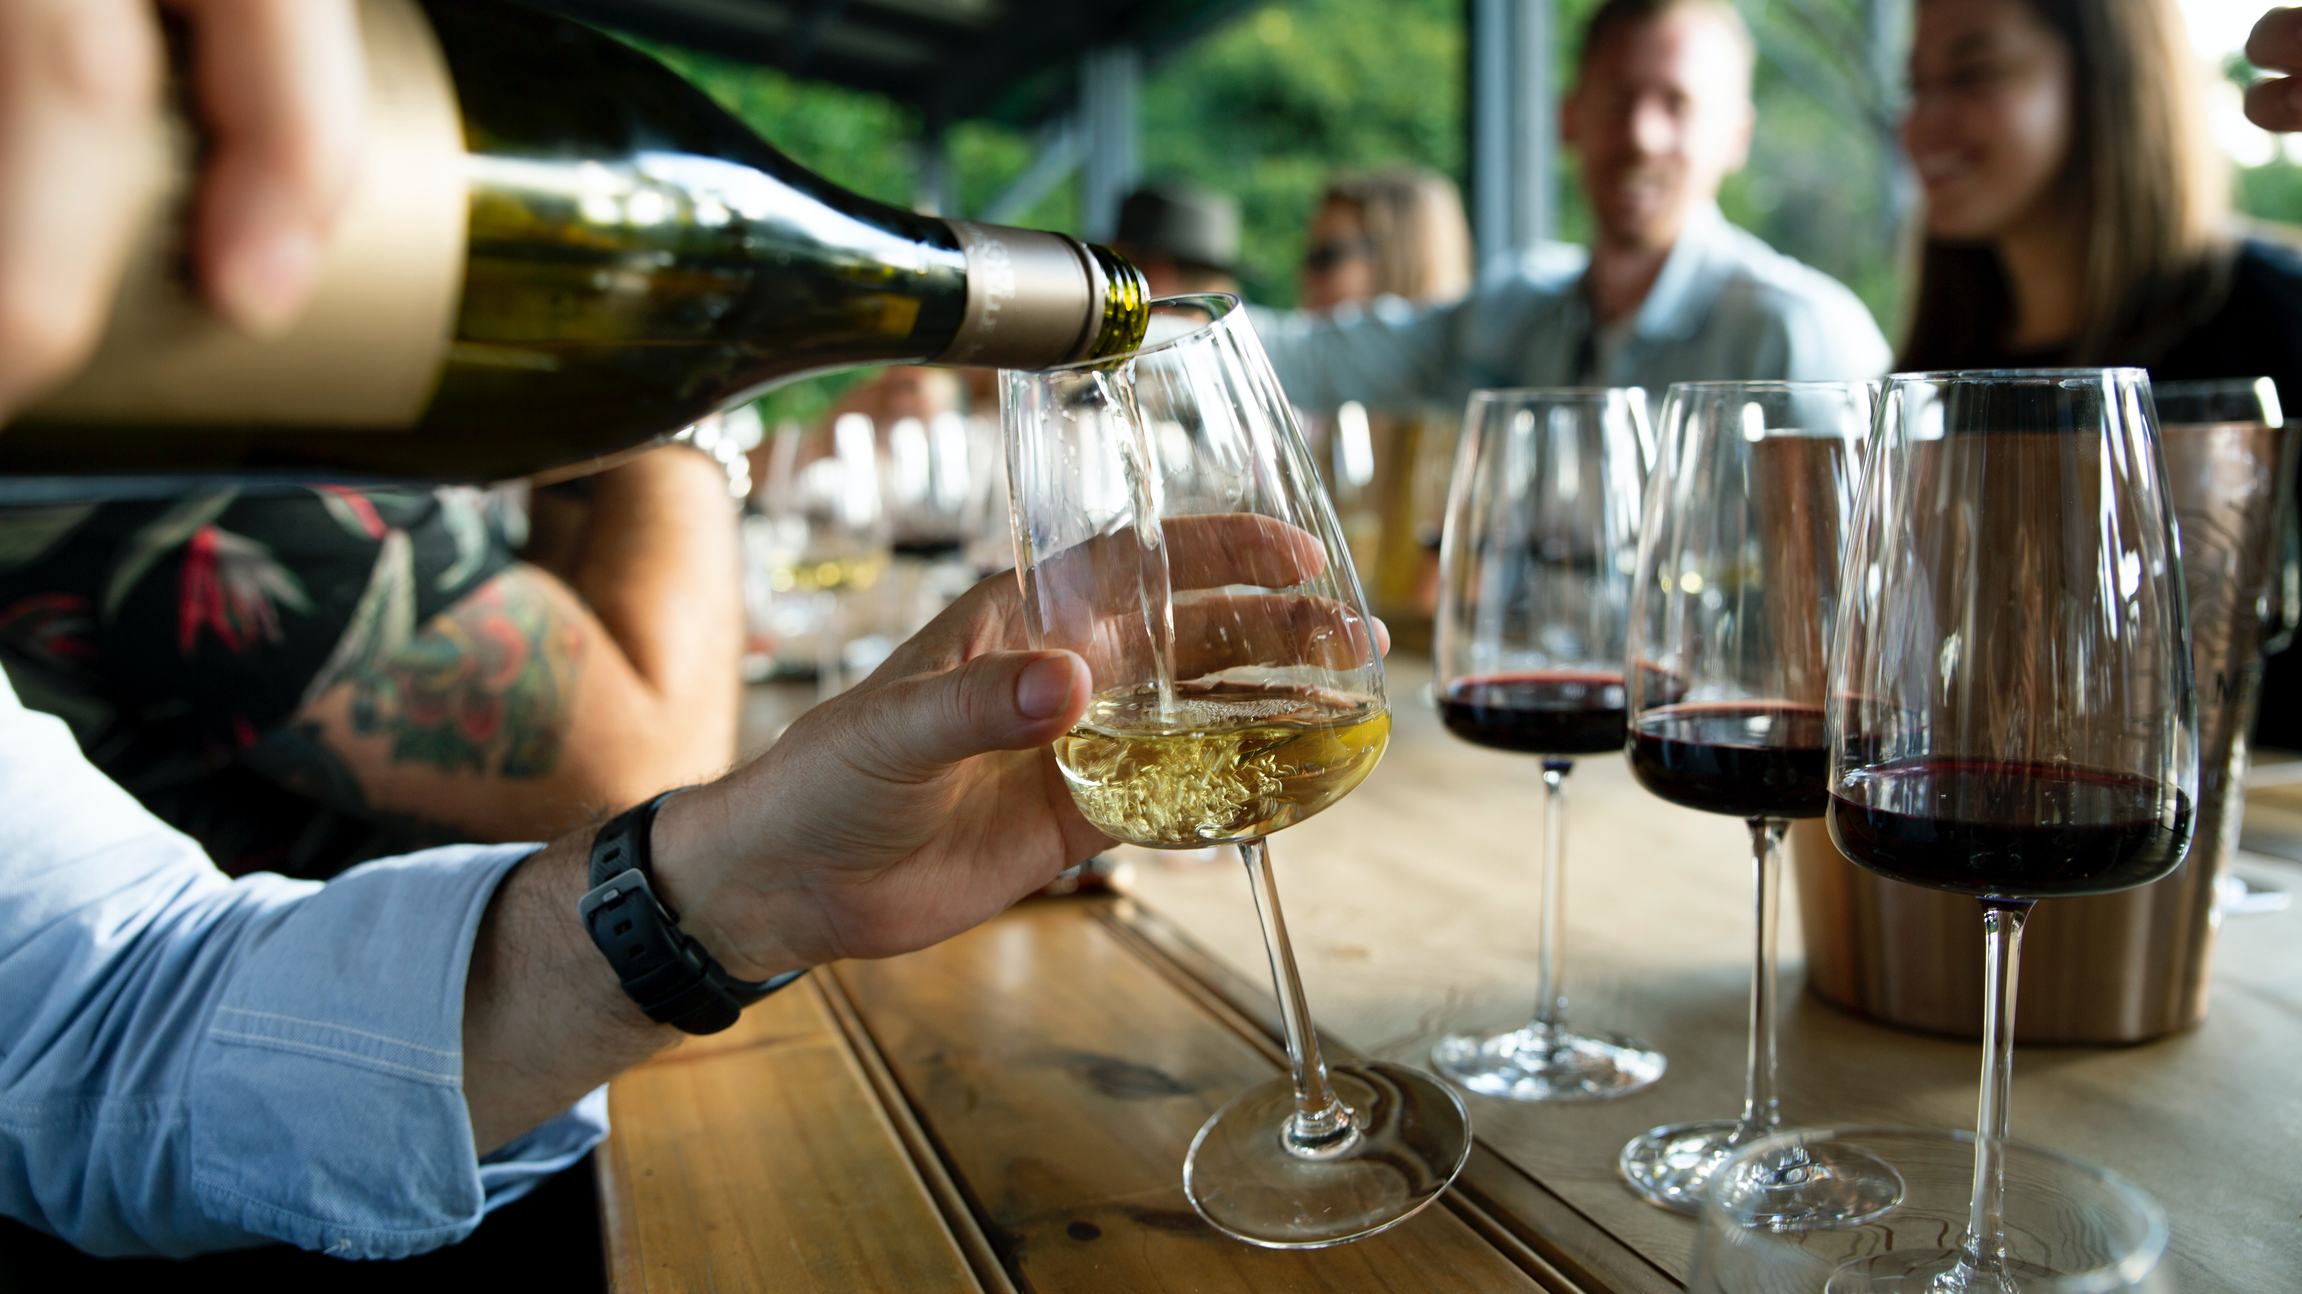

Slide 6
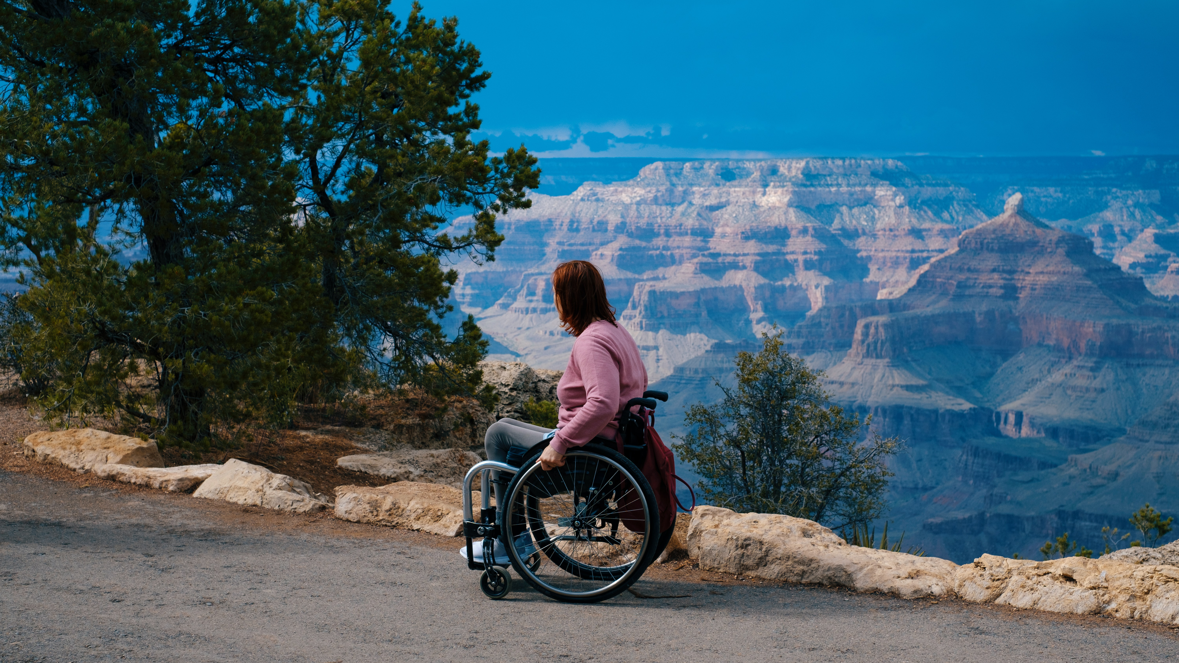

Slide 7
Philosophical Evolution of Destinations
Marketing
Management
Development
Resilience
Sustainability
Stewardship

Slide 8
What is Destination Stewardship?
}
Economics
Quality of Life
Stewardship
Environment
Visitor Experience

Slide 9
Case Studies

Slide 10
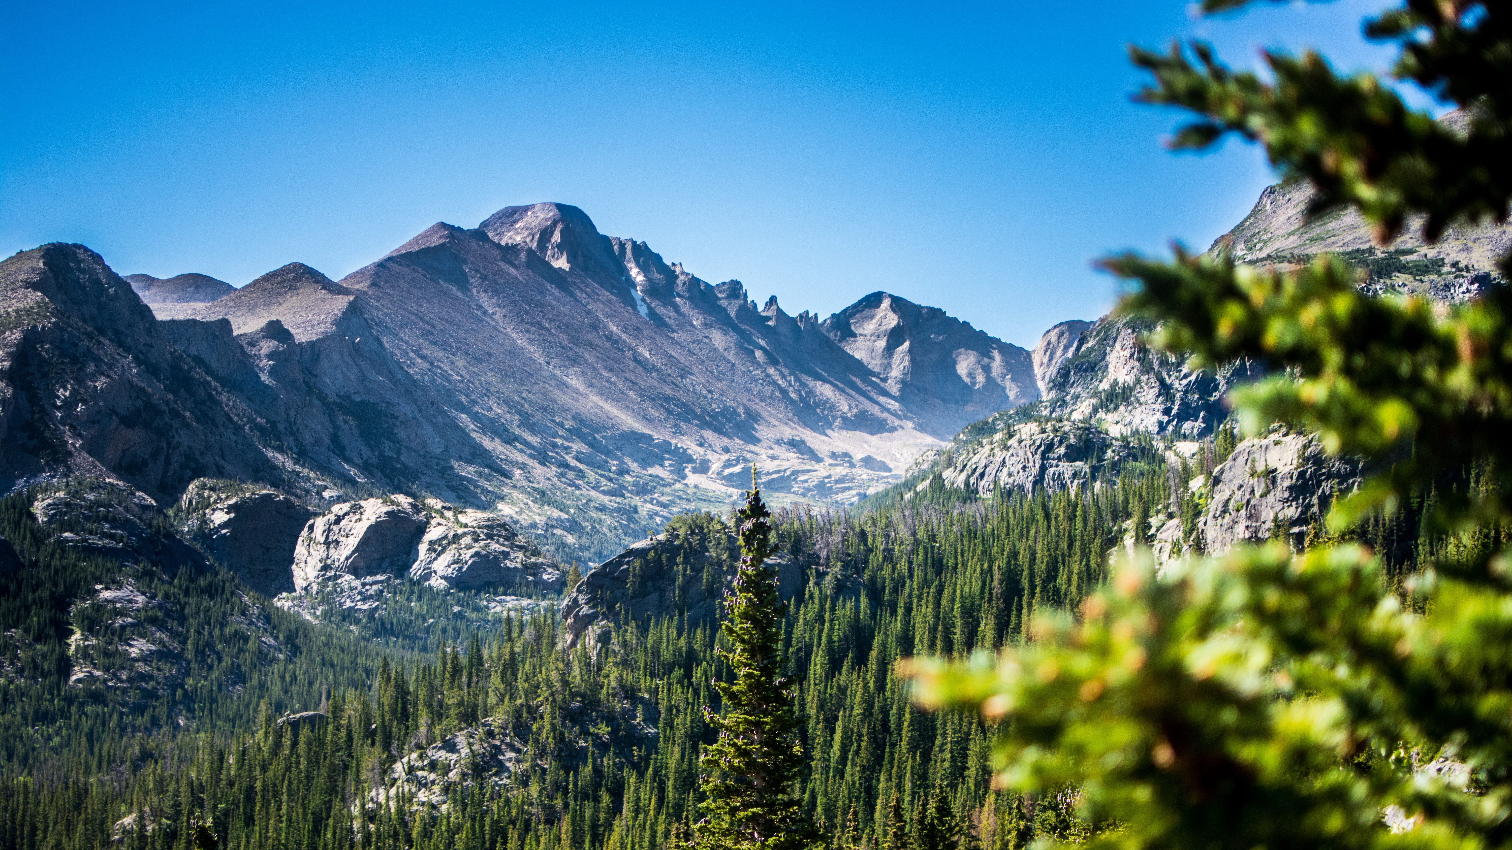
Economics: Colorado

Slide 11
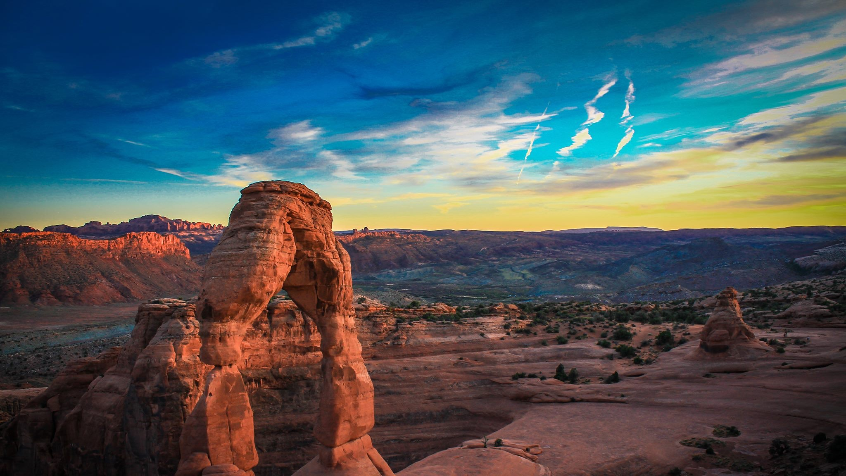
Quality of Life: Moab

Slide 12
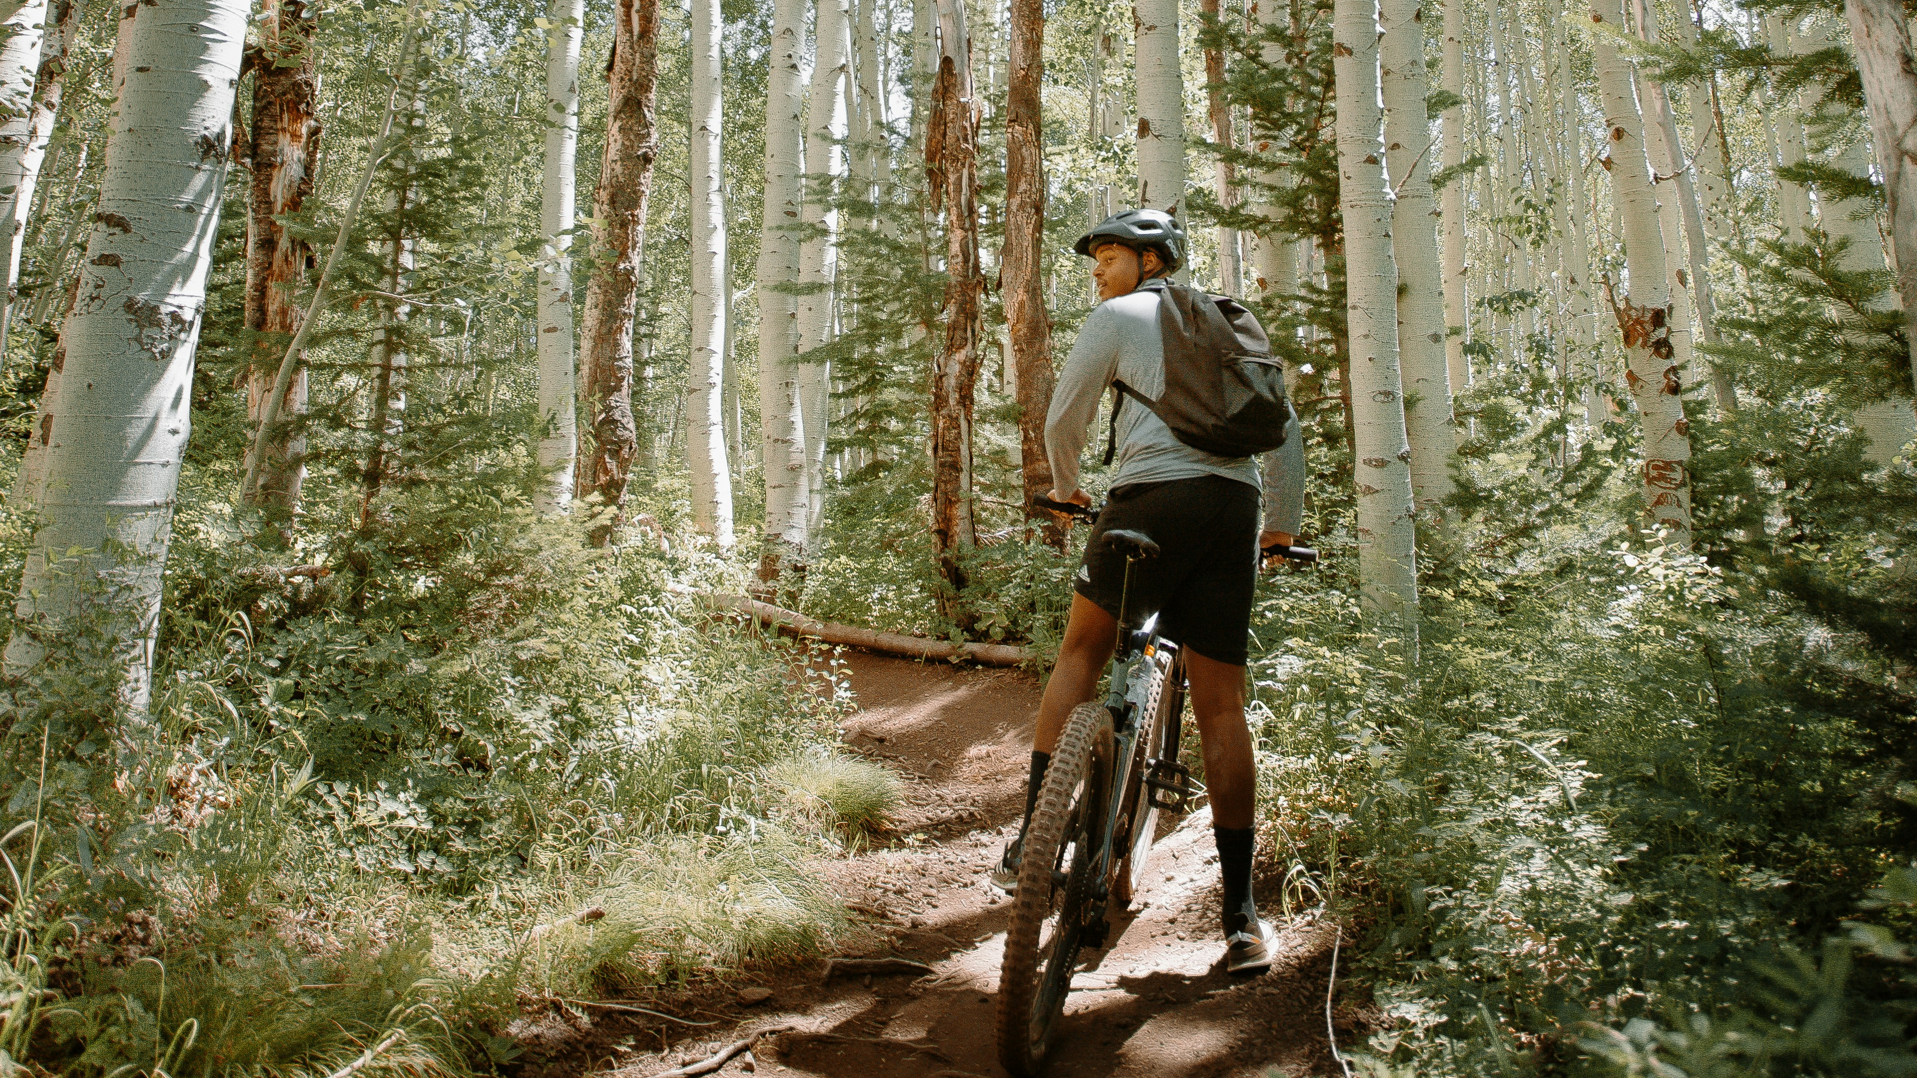
Environment: Park City

Slide 13
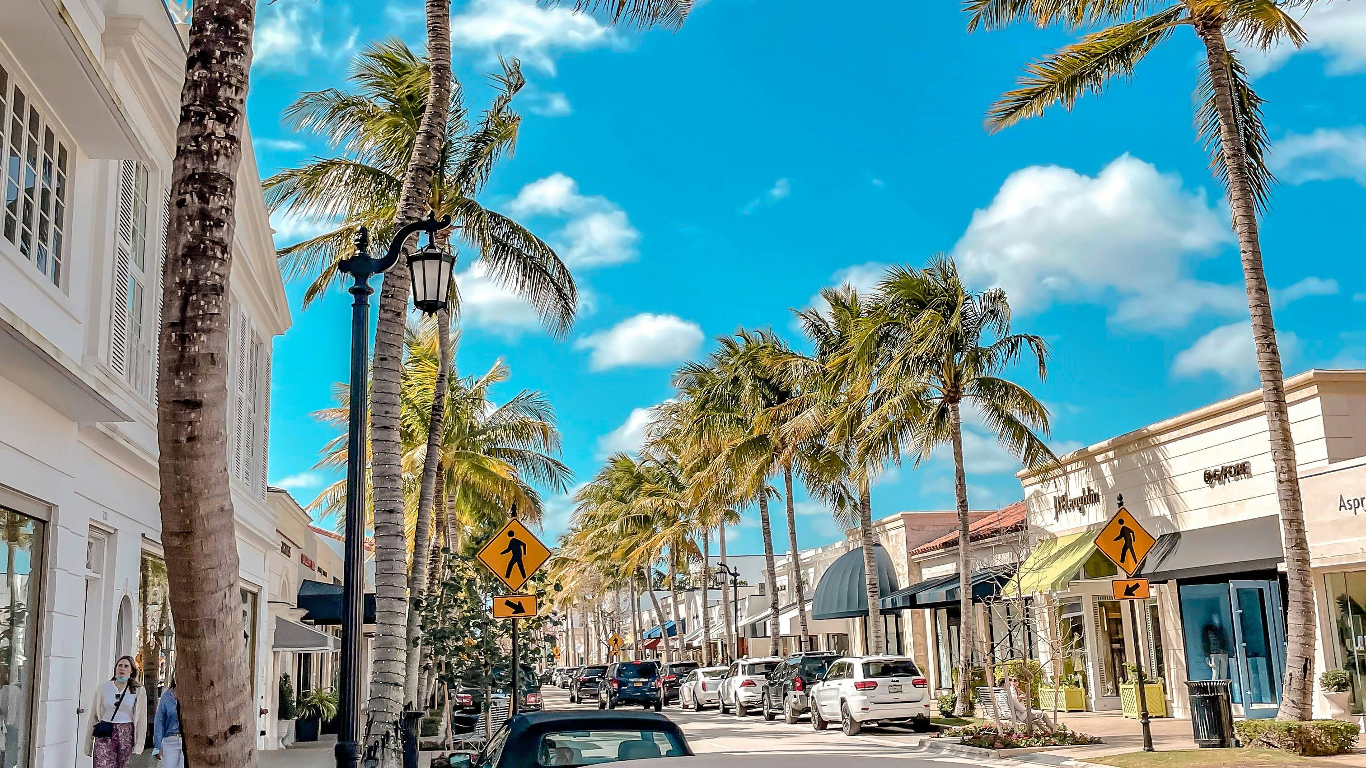
Visitor Experience: Palm Beaches

Slide 14
Three Things You Can Do

Slide 15
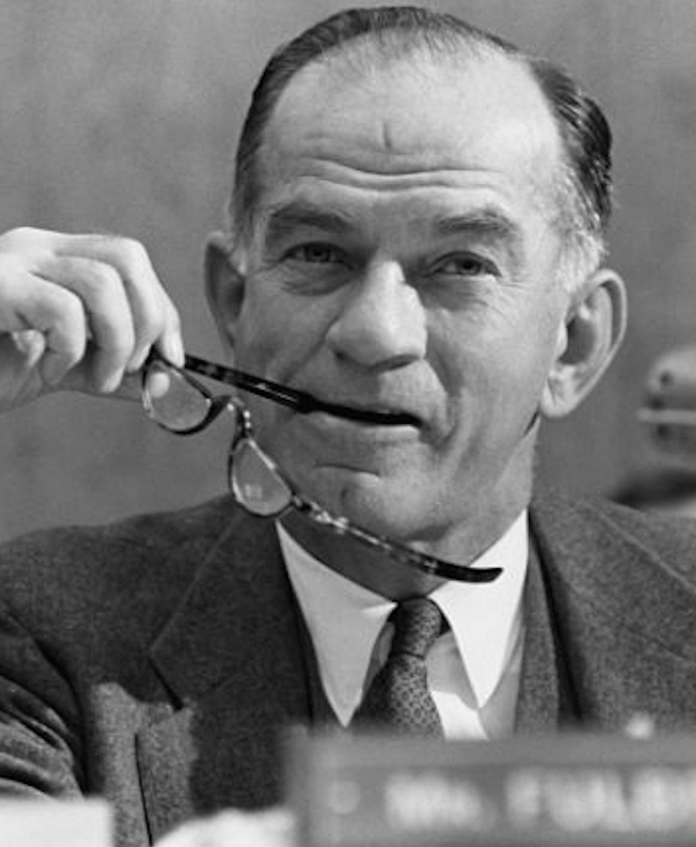
“We must dare to think 'unthinkable' thoughts. We must learn to explore all the options and possibilities that confront us in a complex and rapidly changing world.”
—J. William Fulbright

Slide 16

1: Watch the Future

Slide 17
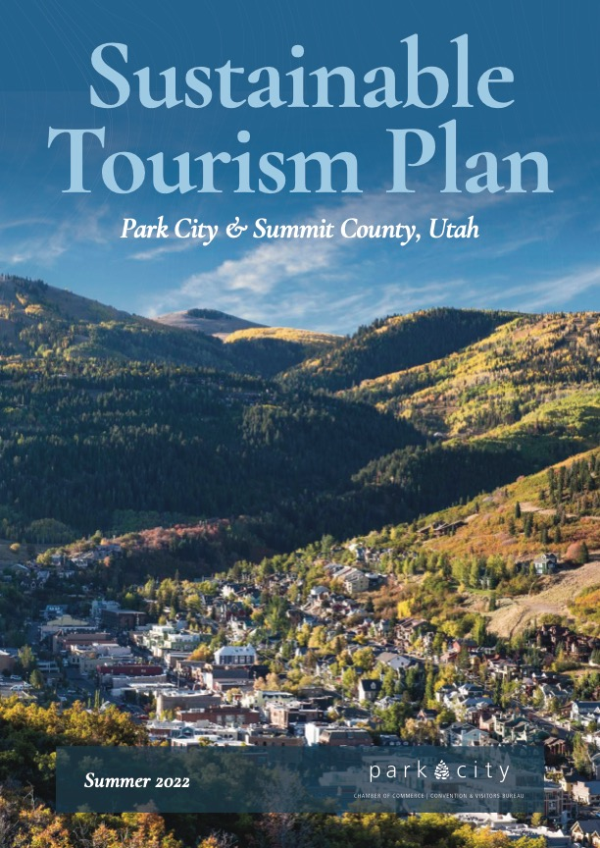
Visit Park City: Leading Indicators
Average annual Utah snowpack
Annual number of days with Summit County Air Quality Index greater than 151
Ratio of Average Monthly Wage for Leisure & Hospitality sector in Summit County to Summit County median home price
Ratio of Utah to national population growth
Ratio of GDP attributed to outdoor recreation in Utah compared to the nation
Annual percent of travelers who consider the environmental impact of their travel
Count of GSTC Assessments complete and/or underway in North America
Ratio of county public transit ridership to county population
Percentage of Utah residents saying positive effects of tourism outweigh the negative
Ratio of number of homes that qualify for primary residence exemption to total homes in Summit County

Slide 18
Visit Park City: Leading Indicator Example
Leading Indicator
Percentage of Utah residents saying positive effects of tourism outweigh the negative
Benchmark
Kem C. Gardner Resident Sentiment Survey, February 2022: 59% agree

Slide 19

Visit Park City: Data Tracking
R² = .93

Slide 20



trends
stories
strategies

Slide 21
takeover of autonomous vehicles
MASS MOVEMENT
Visitors arrive in autonomous group vehicles
Group activity asset development
Creation of multiple automated itineraries
POD PEOPLE
Visitors arrive in autonomous on-demand electric cars
Reduced need for parking
All participants can see sights
Promote relaxing experience
death of the personal vehicle road trip
electrification of the road trip
LAND CRUISERS
Group tours in driver-operated buses
Provision of well-trained tour guides as drivers
Market enrichment of the road trip; educational opportunities
BORN TO BE WIRED
Classic road trip culture, but electrified
Still need parking lots, but with charging infrastructure
Market individuality and freedom of the open road
persistence of driver-operated vehicles

Slide 22




no regret moves
little bets
options & hedges
big bets

Slide 23
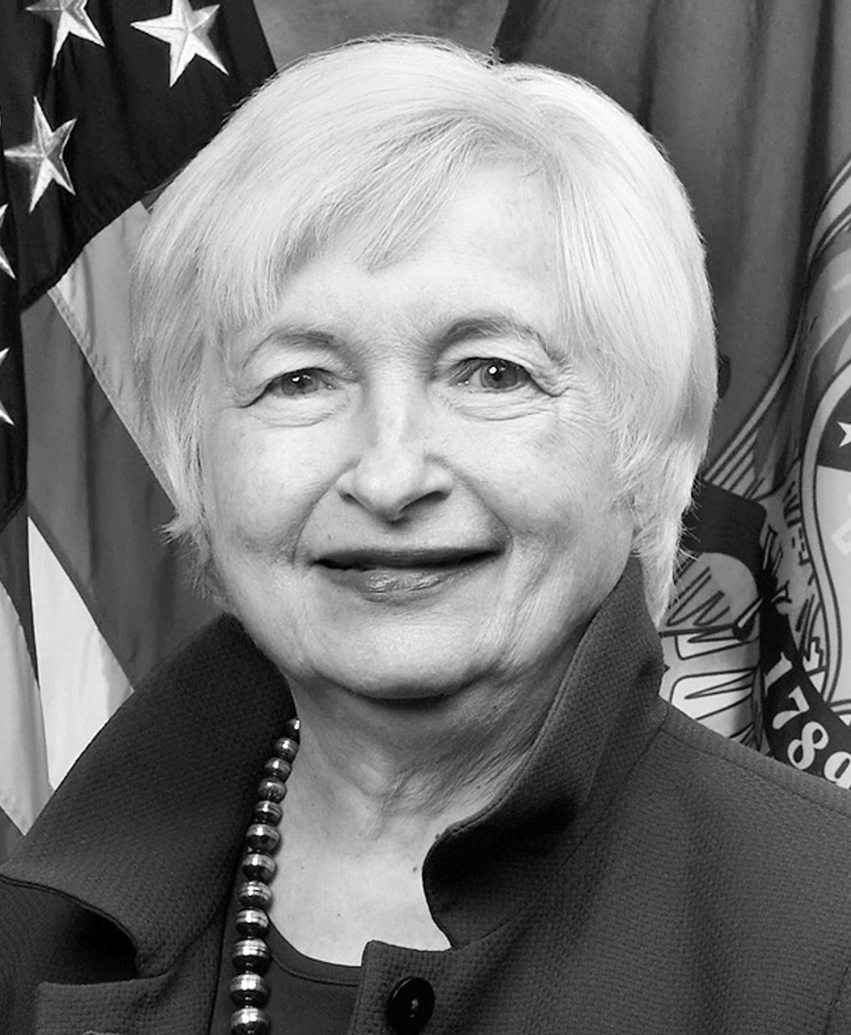
“Listening to others, especially those with whom we disagree, tests our own ideas and beliefs. It forces us to recognize, with humility, that we don't have a monopoly on the truth.”
—Janet Yellen

Slide 24
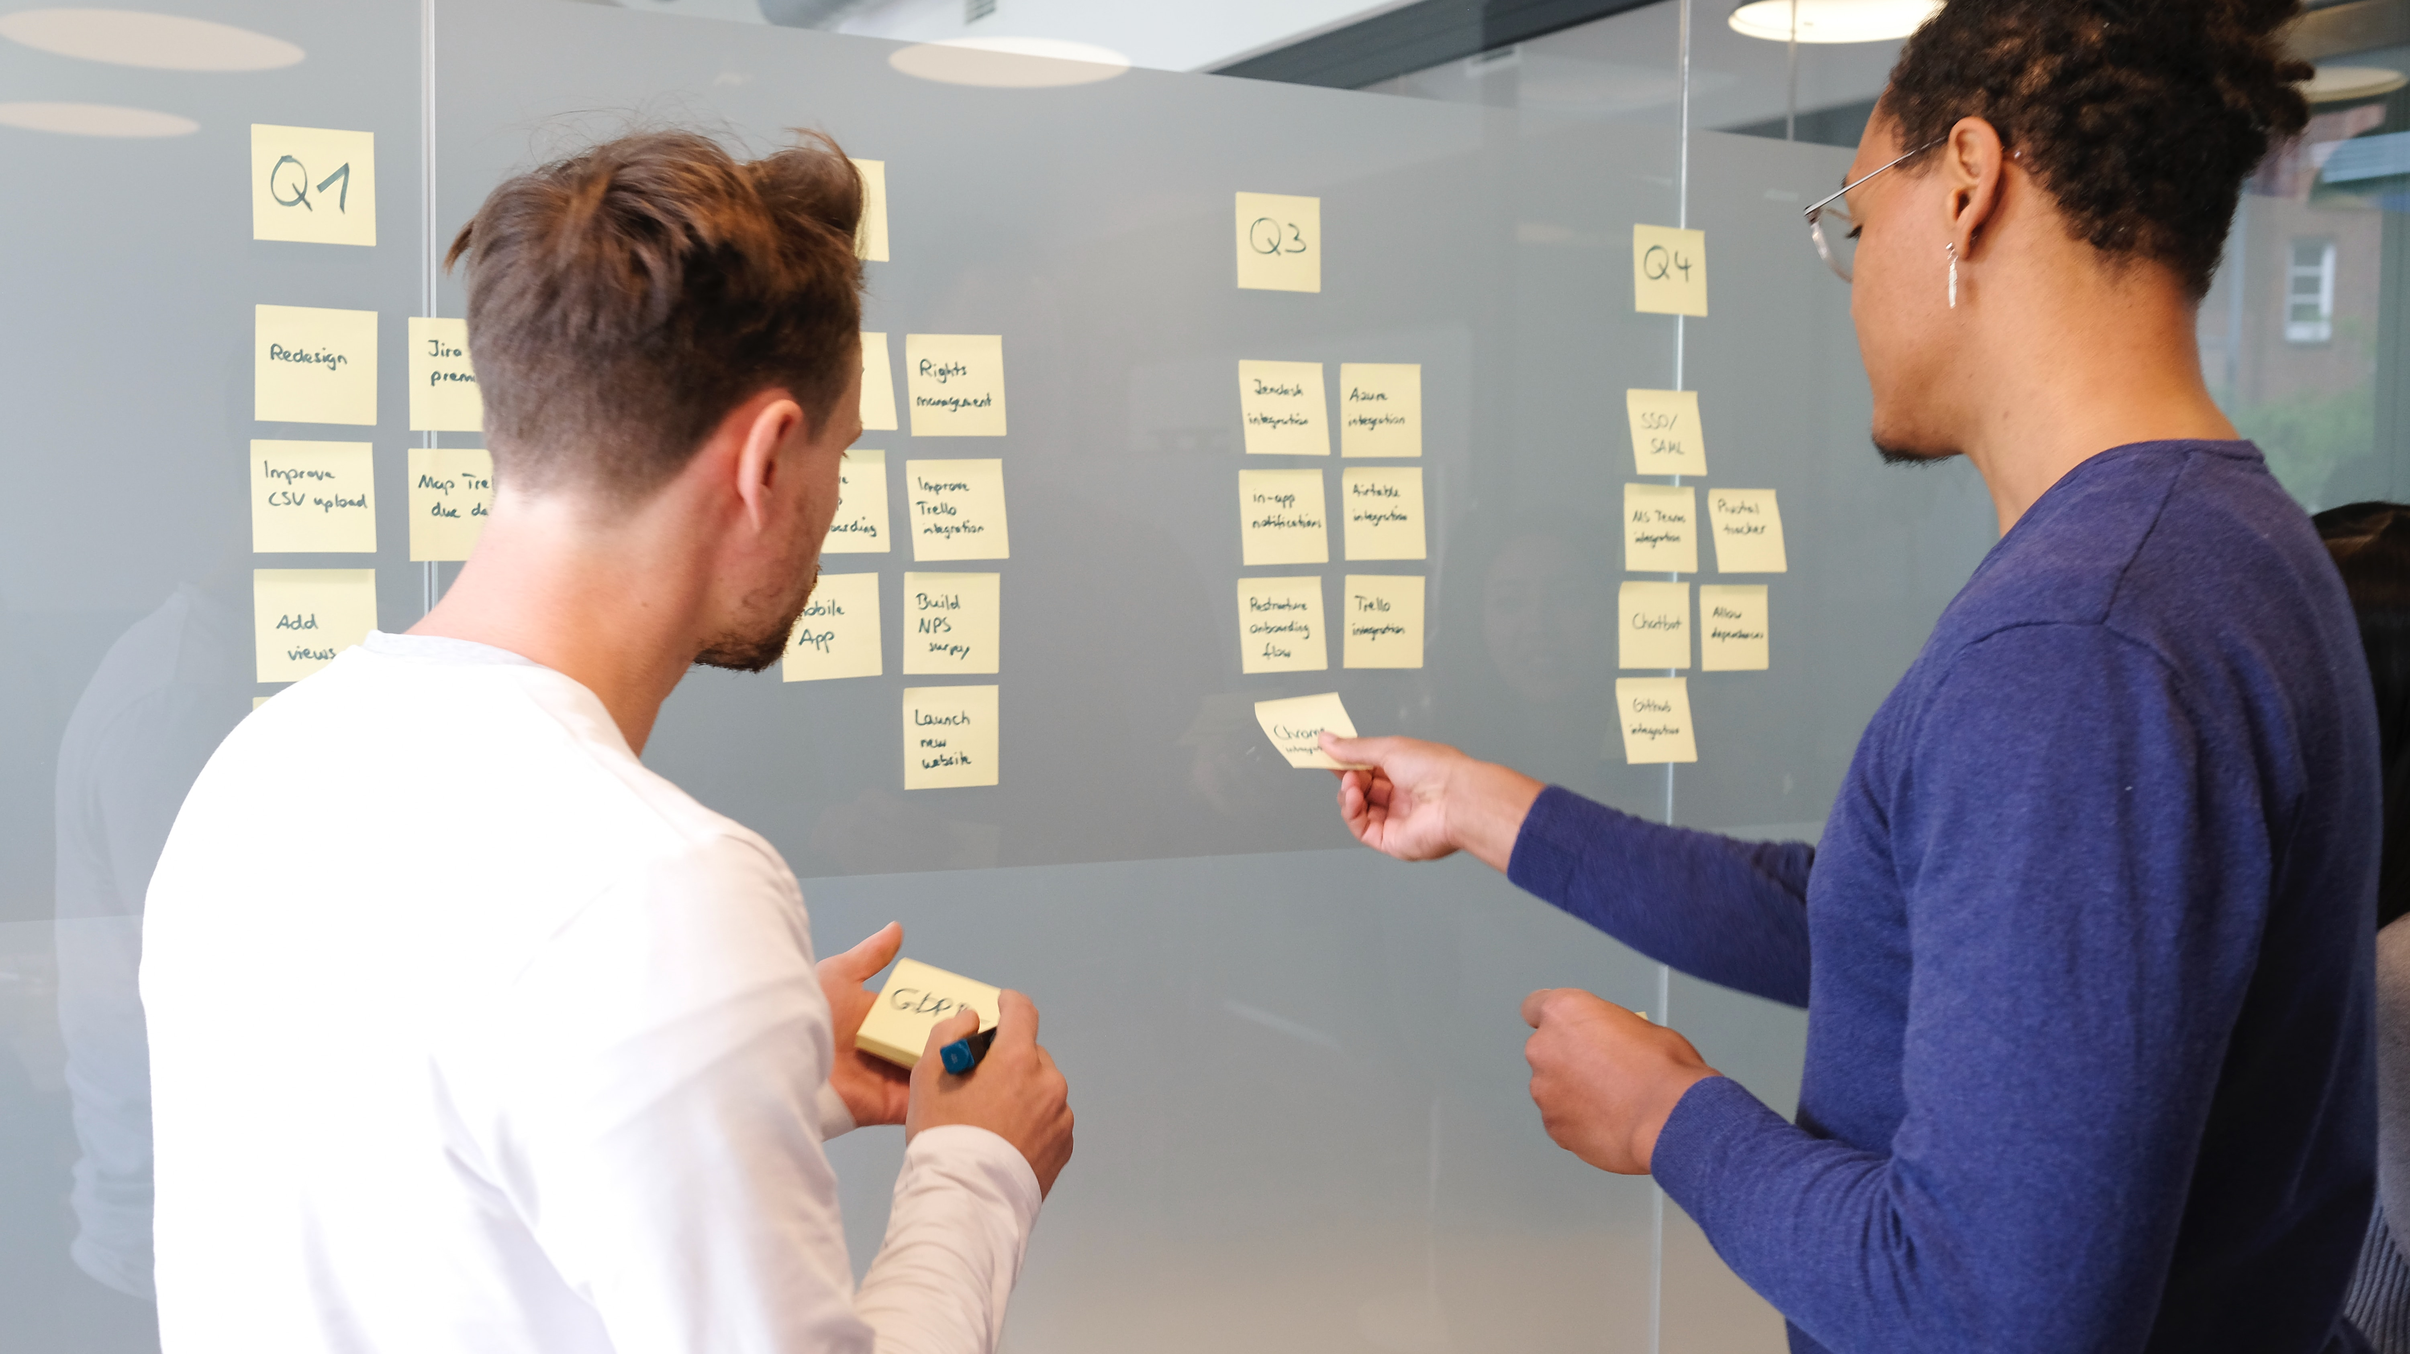
2: Listen Now

Slide 25


Slide 26
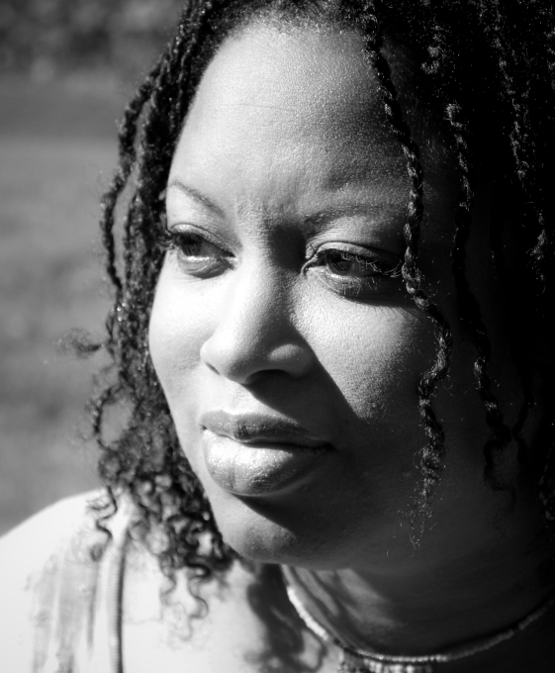
“If everyone helps to hold up the sky, then one person does not become tired.”
—Askhari Johnson Hodari

Slide 27

3: Build Coalitions

Slide 28
Communication

Slide 29
Coordination

Slide 30
Cooperation

Slide 31
Collaboration

Slide 32

If You Weren’t Taking Notes:
Destination stewardship means taking care of:
  Economics
  Quality of Life
  Environment
  Visitor Experience
Three things you can start with:
  Watch the Future
  Listen Now
  Build Coalitions

